Slide 1

A revolutionary IoT Platform
The Raspberry Pi 3
Introductory course

Slide 2
Raspi 3 – About
A Single Board Computer (SBC)
  Fully functional networked computer
  Just needs a display, keyboard, mouse
Developed by the Raspberry Pi Foundation, UK
  Primarily as an educational tool
  www.raspberrypi.org

Slide 3
Raspi 3 – Goals
Goals of the Raspberry Pi project
  Children
    Promote computer usage, make programming “joyful”
  Students
    A platform for school and college projects
  Hobbyists
    A ready framework for hobby projects, learning
  SMEs:
    A starting point for embedded project/product development

Slide 4
Raspi – Response
Very well-received by the community at large
  Sales touched 2 million units by mid-Nov 2013
Many UK, US, EU universities recommend Raspi as a default project platform
Awards:
  Nominet Outstanding Contribution to the Internet
    July 2012
  T3’s Innovation of the Year Award
    Oct 2012
  Index:2013 PLAY (Design) Award
    Aug 2013

Slide 5
Raspi – Projects!
  Full blown Media Centre
  Air Quality Monitor
  EyeTracking
  Private Cell Phone Network Base Station
  Maneuverable robot controller
  Flying high into space and sending sky-high images
  High-end Gaming Console
  BerryTerminal (Thin Client)
  Home Automation, Monitoring
  Video Streaming Server
  Digital Signage Controller
  Data Centre / Cluster Server

Slide 6
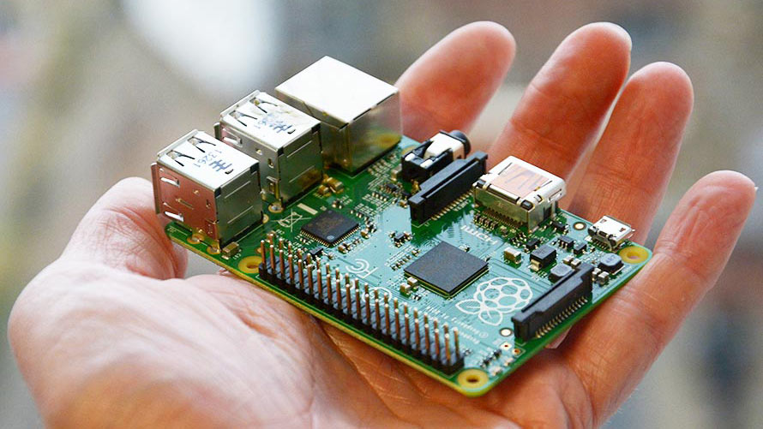
Raspi 3 – A hand-held SBC!

Slide 7
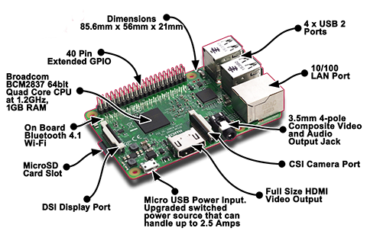
Raspi 3 – Interfaces (board view)

Slide 8
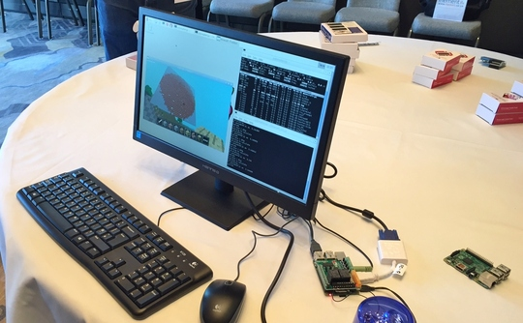
Raspi 3 – Fully hooked up

Slide 9
Raspi 3 – Hardware
SoC (BroadCom BCM2837)
CPU
  Quad-core ARM Cortex A53
    Each core @ 1.2 GHz
VPU/GPU
  VideoCore IV @ 250MHz
  H.264 1080p30 (decode + encode)
  MPEG-2 & VC1 1080p30 (decode)
  Graphics Core (2D, 3D)
    OpenGL ES 2.0, OpenVG
Memory
  1 GB RAM (shared with CPU)
Boot medium, storage:
MicroSD Card slot
Network
10/100Mbps Ethernet
Inbuilt WiFi and Bluetooth
Ports
Input
  Video: CSI connector
Output
  Video:
    Composite RCA
    HDMI
    DSI (for raw LCD panels)
  Audio:
    3.5mm jack
    HDMI
    I²S audio
4 USB2.0 ports
Low-level peripherals:
  GPIO, UART , I²C, SPI

Slide 10
Raspi – Software (OS)
Bare-metal OS-less images
Full Operating Systems
  Linux kernel based:
    Debian Linux port called Raspbian “Jessie”
    OSMC (XBMC-based media centre)
    Arch Linux ARM
    Fedora
    Ubuntu
  Windows:
    Windows 10 IoT Core (introduced by M$)
  RISC OS

Slide 11
Raspi – Software (Apps)
Fully functional desktop (using PIXEL)
Chromium Web Browser
Wolfram Mathematica
Programming language support (default)
  Python
  C
  C++
  Java
  Ruby
  Wolfram
  Scratch

Slide 12
Raspi – Bringup (1/2)
We’ll use the NOOBS (offline and network install) distribution to bring the Raspi up
  NOOBS – “New-out-of-the-box”
    Contains Raspbian Jessie
Raspi boots from MicroSD card (min 4GB, prefer 8GB)
  This SD card has to be prepared for Raspberry Pi
Steps in preparing the SD card
  Format the SD card using SDFormatter (Windows)
    In the OPTIONS menu, select “FORMAT SIZE ADJUSTMENT” to “ON”
  Copy the NOOBS zip file contents to SD card

Slide 13
Raspi – Bringup (2/2)
Raspi Boot Menu bringup
  Insert prepared MicroSD card in Raspi’s SD card slot
  Connect HDMI output to monitor using HDMI cable
  Connect USB keyboard and USB mouse
  Apply 5V power to Raspi
Raspi boots from Micro SD card, presents options screen
Select US English and US keyboard (if applicable)
Select Raspbian for install
  Raspbian will take ~5mins ^{(Class 10)} /~20 mins ^{(Class 4)} to install
Post-Raspbian install, power-boot the Raspi
  It should come up with Raspbian Jessie Linux

Slide 14
Raspi – 1st run config
Run a Terminal
  # sudo raspi-config
Select 8 Advanced, and A4 SSH to enable SSH login
Reboot if you change any options in raspi-config
You could also opt to:
  Change default time-zone (4 Internationalization, I2 Change Time Zone)
  Change keyboard layouts (4 Internationalization, I3 Keyboard Layout)
If we have a Raspi Camera sensor, it is to be enabled here

Slide 15
Raspi Interaction: Terminal
Terminal is a command-line interface to interact with the Linux kernel running on the Raspi
Invoked by double clicking on the “Terminal” icon
  This will give a DOS-like interface for typing commands
Open a “term” and type “date”
  Exact time will be random*
  But Time Zone should be whatever we set earlier (IST)
*unless it gets time via NTP!

Slide 16
Raspi Boot-time Messages: dmesg
The command “dmesg” shows the various things that took place during the Pi’s boot
  Board processor (CPU)
  Linux kernel that booted the system
  OS modules that got loaded
  Hardware that was detected
Pipe the output of “dmesg” to more to see 1 screenful at a time
  dmesg | more
You can spot the USB keyboard, mouse, etc that the Linux kernel detected in these messages…

Slide 17
Raspi Control: SSH
If SSH is enabled, it is possible to log in to, and control the Pi remotely
On a PC terminal-software (like PuTTY):
  ssh pi@<IP address of Pi”
  Enter pi’s password (default: raspberry)
You should get a login prompt on the Pi
Confirm by checking user pi’s Home Directory, and also the number of people logged in
  Issue “w” command in a Pi terminal

Slide 18
Raspi File transfer: WinSCP
We transfer files using the SCP (secure copy) protocol
Use WinSCP program for transferring files to and from Pi and PC

Slide 19
Raspi
File transfer (Windows – Linux)
Use SMB/WINS protocol to share a folder on Raspi
On an Raspi terminal:
  Type “sudo apt-get install samba samba-common-bin”
  This installs the Samba client
  Change entries in Samba’s conf file:
    Type “sudo nano /etc/samba/smb.conf”
    In the editor, add the following section:
        [pihome]
        comment= Pi
        path=/home/pi
        browseable=Yes
        writeable=Yes
        only guest=no
        create mask=0777
        directory mask=0777
        public=no
    Save the file
  Type “sudo smbpasswd –a pi” and enter pi’s password twice
  Type “sudo smbd restart”
Now you should be able to see pi’s home folder from any Windows PC
  In Explorer, enter “\\<IP address of Raspi>\pi”
Debug logs available at /var/log/samba/log.<PC>
Status available through the command: smbstatus

Slide 20
Raspi - Keeping up to date
Open up a terminal on the Pi
Type “sudo rpi-update”
  This will connect to the Raspi public servers and download latest updates to Raspi firmware, OS and applications
After the update goes through, reboot the Raspi
  Type “sudo reboot”

Slide 21
Embedded “Time”
All embedded devices need a concept of “time”
  This enables them participate in real-time transactions
  Certain functional areas require time to be sync’d accurately
    Finance / Stock trading
    Location / GPS / Real-time tracking
    Security / Video Surveillance
Getting a sync’d time – options
  External
    Internet (NTP)
    Local Area Network having a dedicated NTP server
  Internal
    RTC
Issues with NTP
Advantages of RTC

Slide 22
Raspi: Time and constraints
Raspi will run an NTP client by default
  Try to get time from the internet
  Type: $ date and verify time is “current”
But what if there is no network connection?
Or the network does not permit NTP connections?
Enter RTC (Real Time Clock) Module
  This RTC is on the “I²C bus”

Slide 23
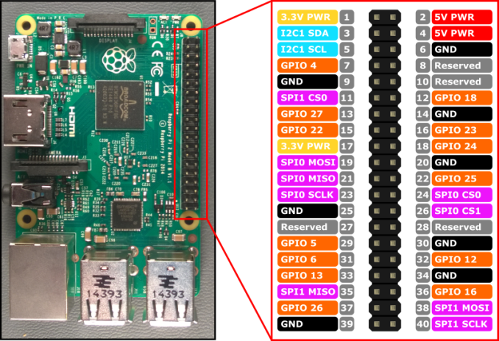
Raspi3: GPIO Pinout

Slide 24
Raspi Time: I²C RTC (1/2)
Disable Pi’s ntp by $ sudo apt-get remove ntp
Enable the i2c bus by selecting from raspi-config:
  8 Advanced Options
    A7 Enable automatic loading of i2c module
Install i2c tools:
  $ sudo apt-get install python-smbus i2c-tools
Enable i2c loading at boot-time:
  Add i2c-dev as a loadable module in /etc/modules
  Add user pi to i2c group: $ sudo adduser pi i2c
Connect RTC module with Pi off, and boot up
  $ sudo i2cdetect –y 1
  -> should show a device at address 0x68
Add new device to the sysfs entry through a root shell (sudo bash)
# echo ds1307 0x68 > /sys/class/i2c-adapter/i2c-1/new_device
Check current hwclock time:
# sudo hwclock –r
-> this shows a random time (this is the Pi’s hwclock on the RTC chip)

Slide 25
Raspi Time: I²C RTC (2/2)
Set the time on Pi, and save it to the RTC chip
# sudo hwclock –w
-> Now the RTC chip will remember this time!
Make the module load at boot-time by adding it (rtc-ds1307) to /etc/modules
Also, make the Pi load its hardware clock every time it boots by adding entries to /etc/init.d/rc.local
echo ds1307 0x68 > /sys/class/i2c-adapter/i2c-1/new_device
sudo hwclock -s

Slide 26
Raspi: GPU - probing
vcgencmd – a utility to probe and get various information about the board, in particular the ARM, SDRAM and GPU
  $ vcgencmd version
  $ vcgencmd commands (not all are documented!)
  $ vcgencmd get_lcd_info
  $ vcgencmd measure_clock …
  - options: arm, core, h264, uart, hdmi, emmc
  $ vcgencmd measure_volts …
  - options: core, sdram_c, sdram_i, sdram_p
  $ vcgencmd measure_temp
  $ vcgencmd get_mem …
  - options: arm, gpu
  $ vcgencmd codec_enabled
  - options: MPG2*, H264, WVC1*, MPG4, MJPG, WMV9*
  $ vcgencmd otp_dump
  - locations 28 and 30 contain Serial and Revision #’s
  * Codecs’ licenses need to be purchased from Pi Store on a per unit basis

Slide 27
Raspi: GPU /opt/vc utils
/opt/vc/src/hello_pi contains Broadcom released sample code for GPU
  hello_world
  hello_triangle, hello_triangle2
  hello_teapot, hello_videocube, hello_tiger
By default, gpu_mem is set to 64M (very low)
  Causes high-end graphics like hello_teapot fail
Sharing of 1GB SDRAM between ARM and GPU is controlled at boot-time by /boot/config.txt (gpu_mem=?)
  Change “gpu_mem” to higher value (say 512) and reboot
Now vc utils sample codes should run “better”
  Also, note the output of vcgencmd get_mem arm/gpu now!

Slide 28
Raspi: AV playback
AV playback can use either the ARM or the GPU
  Typical software media players (like mplayer or VLC) use the ARM
  Dedicated media players like omxplayer use the GPU
Demonstrate the difference in playback experience and ARM CPU usage using the 2 different types of players
  omxplayer –o hdmi/local/both <file_name>
    controls audio output from chosen interface

Slide 29
Raspi: Media Server (Kodi / OSMC)
OSMC is a full-blown dedicated and optimized Linux distribution dedicated to Media Server Application
  Demo of Raspi running OSMC
  Demo of Raspi running audio and video from an attached USB stick
Kodi is an application for a media centre
  Concept of add-ons
  Demos
  It’s possible to hook up an IR sensor (receiver) and control media playback using standard IR remote
    http://kodi.wiki/view/Raspberry_Pi#Remote_controls

Slide 30
Raspi: GrovePi introduction
We can interface all Grove Sensors to the Pi using the GrovePi+ board
  GrovePi+ is an Atmel microcontroller powered board with 15 4-pin interfaces ranging from digital to analog to buses like i2c and SPI
  Fast SPI and reliable UART connections
  Easy to assemble with ready-made well-defined cables
  Simplified firmware update (Atmel)
    Raspi and Atmel talk over i2c, using avr toolchains and utilities

Slide 31
Raspi: GrovePi setup
Do not attached the GrovePi to the Pi yet!
Get the GrovePi framework
  git clone https://github.com/DexterInd/GrovePi
Run the installer from GrovePi/Scripts
  $ chmod +x install.sh && sudo ./install.sh
The Pi will reboot. Now attach the GrovePi
GrovePi’s Green Led should now start glowing
$ sudo i2cdetect –y 1
-> should now show 0x04 (GrovePi’s address)

Slide 32
Raspi: GrovePi usage
GrovePi has a ready-to-use Python-based software library for interfacing a variety of sensors (in GrovePi/Software/Python)
  Button (grove_button.py)
  Buzzer (grover_buzzer.py)
    Button & Buzzer – Let’s learn some Python!
  Thumb-joystick (grove_thumb_joystick.py)
  4-digit display (grove_4_digit_display.py)
    Might need a firmware update
    $ ./firmware_update.sh (in GrovePi/Firmware/)
  Temperature (grove_temperature_sensor.py)
    Check sensor version #!
  3-axis accelerometer (grove_i2c_accelerometer.py)
  Touch (grove_touch_sensor.py)

Slide 33
Raspi Oscilloscope: Piscope
The Raspi board can be used as a low-end digital oscilloscope
  http://abyz.co.uk/rpi/pigpio/piscope.html
Uses the pigpiod daemon, collects signals on the GPIO pins, displays them graphically
Steps:
  # sudo pigpiod
  # wget abyz.co.uk/rpi/pigpio/piscope.tar
  (Untar, make hf, make install)
Tracks all GPIO pins including I2C and SPI
  Run a grovepi .py sensor example to see i2C
  Run a firmware update to see SPI

Slide 34
Raspi: Graphics and Imaging
XV – age-old image browser/editor/processor
  Let’s make it run on the Pi
    An exercise in OSS S/W Build
  Src code:
    ftp://ftp.trilon.com/pub/xv/xv-3.10a.tar.gz
  Compiling:
    libX11-dev, libxt-dev needed + src code changes!
OpenCV can be compiled on Raspi (~35mins native compile for OpenCV3.10)
  Imaging, Graphics, Image Processing, Image Analysis, Machine Learning
QTonPi project
  QT (OS-independent UI framework) on RasPi
piNGL (NCCA Graphics library – NGL on RasPi)
  http://nccastaff.bournemouth.ac.uk/jmacey/GraphicsLib/piNGL/index.html
High-end graphics possible using Raspi’s GPU
  OpenMax and OpenGL pipelines
GPU transcoder
  …in the works!

Slide 35
Raspi: Pi Camera details
The Pi can handle various USB cameras (webcams)
The Pi also has a dedicated camera module
  OmniVision OV5647 sensor
  Ultra small (3 grams), fits directly into the CSI port of the Pi
  Image mode: 2592 x 1944
    Standards: JPEG (GPU), RAW, GIF, BMP, PNG, YUV420, RGB888
  Video modes : 1080@30, 720@60 and 640x480@60/90
    Codec: H.264
  Has full Linux V4L2 support as well as OpenMax

Slide 36
Raspi: Camera module usage
Run raspi-config and select 5 Enable Camera
Connect the camera module and boot the Pi
Utils:
  Imaging:
    raspistill –v –o a.jpg
  Video:
    raspivid –v -0 a.h.264 –t 10000 (10 secs live recording)
    raspivid –f (preview for 5 seconds)
    raspivid –f –ex …
      control exposure: auto, night, snow, verylong, sports, …
    raspivid –f –ifx …
      effects: negative, sketch, emboss, oilpaint, hatch, pastel, blur, film
    raspivid –-rotation 0,90,180,360 (rotation)
    raspivid –hf, -vf (horizontal and vertical flip)
    raspivid –roi x1,y1,x2,y2 (region of interest – zoom)

Slide 37
Raspi: Surveillance (Jessie)
We will use a standard USB-webcam software “motion”
  $ sudo apt-get install motion
  $ sudo apt-get remove motion (!!)
  $ sudo apt-get install libjpeg62
  $ sudo apt-get install -y libjpeg-dev libavformat56 libavformat-dev libavcodec56 libavcodec-dev libavutil54 libavutil-dev libc6-dev zlib1g-dev libmysqlclient18 libmysqlclient-dev libpq5 libpq-dev
Now get “motion-mmal” binaries
  $ wget https://www.dropbox.com/s/6ruqgv1h65zufr6/motion-mmal-lowflyerUK-20151114.tar.gz
Untar the zip, and edit motion-mmal.conf
  daemon off
  width 640, height 480
  framerate 5
  output_pictures off
  ffmpeg_output_movies off
  lightswitch 0
Start the new motion
  $ sudo ./motion -c motion-mmalcam.conf
Surveillance camera with date and time stamped video will be available for viewing in Chrome at:
  http: <Pi_IP>:8081

Slide 38
Raspi: ARM Gaming – DOOM
chocolate-doom is DOOM built for the Pi
Get helpers:
  $ sudo apt-get install libsdl1.2debian libsdl-image1.2 libsdl-mixer1.2 libsdl-mixer1.2-dev libsdl-net1.2 libsdl-net1.2-dev timidity
Get DOOM source code
  $ wget http://www.chocolate-doom.org/downloads/2.2.0/chocolate-doom-2.2.0.tar.gz
Untar and compile using ./configure, make (-j8 takes ~ 7mins!)
Download a shareware DOOM WAD file
  $ wget http://www.jbserver.com/downloads/games/doom/misc/shareware/doom1.wad.zip
Unzip the WAD file to get DOOM.WAD
Play using ./chocolate-doom –iwad DOOM.WAD
See the 4 cores of the ARM burning to enable game play!

Slide 39
Raspi: GPU Gaming – Quake III
Quake III Arena has been ported to Raspi
Steps to compile and play Quake III for Raspi
  Install helper libraries
  $ sudo apt-get install git gcc build-essential libsdl1.2-dev
  Download the src code
    $ git clone https://github.com/raspberrypi/quake3
  Unzip, modify “build.sh” for Raspi
    ARM_LIBS=/opt/vc/lib
    INCLUDES="-I/opt/vc/include -I/opt/vc/include/interface/vcos/pthreads“
    Comment CROSS_COMPILE=…
    Remove “-lvmcs_rpc_client” from LDFLAGS
  Type “./build.sh”
    It’ll take some time to compile (~ 7mins on Class 4 card)
  The final game binary will be in build/release-linux-arm
    ioquake3.arm
  Quake III needs pak3 files in baseq3 directory
  Type “./ioquake3.arm” from a Raspi terminal to start Quake III…
  Since it’s a GPU-accelerated game
    The load on the ARM will be far less with much better 3D graphics quality
A detailed review of Quake III Arena source code can be found at:
  http://fabiensanglard.net/quake3/

Slide 40
Future directions - software
Learn symbolic math using Wolfram Mathematica
Customize RasPi
  Learn Embedded Linux, Linux porting, Linux device drivers
    Build and compile a custom Linux kernel
    Develop device drivers for custom devices / modules
Use the RasPi’s Graphics Accelerators (VPU) for developing rich media applications and entertainment centres
  OpenMAX
  OpenVG
  OpenGL ES2.0

Slide 41
Future directions - hardware
Interface various hardware such as sensors like GPS, GSM, Bluetooth modules
Use the RasPi’s I²C and SPI buses for device interfacing
Connect MIPI compliant camera modules to the camera connector, capture still images and video
Connect DSI compliant LCD / LED displays and touchscreens on the display connector

